Slide 1

Iran University of Medical Sciences Faculty College of Nursing & Midwifery
Acoustic neuroma pathophysiology

Slide 2
Definition:
Tumour of eighth cranial Nerve.
Vestibular Schwannoma Neurilemmoma

Slide 3
• Incidence:
80% of Cerebellopontine angle tumours
10% of all brain tumours

Slide 4
Pathology
Benign,
Slow-growing
Microscopy

Slide 5
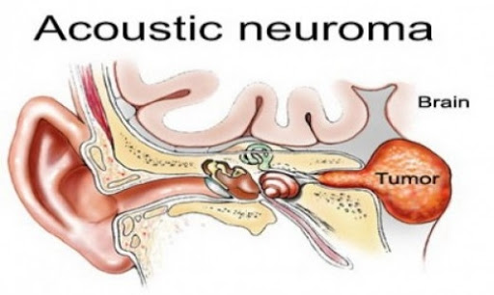

Slide 6
Origin & Growth:
Origin:
Schwann Cells of Vestibular Nerve,
rarely from cochlear nerve
Growth:
(slow)
Causes widening and erosion of the canal and Anterosuperior growth
Later stages: displacement of brainstem, pressure on cerebellum and raised intracranial tension

Slide 7
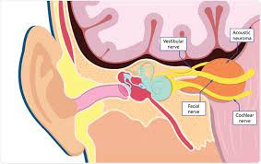

Slide 8
Acoustic neuroma can be caused by:
Constant or continuous exposure to loud noise (such as music or work-related noise)
Neck or face radiation can lead to acoustic neuroma many years later.

Slide 9
What is the hallmark of acoustic neuroma?
One-sided Hearing Loss
Over 90% of people with acoustic neuromas develop some degree of one-sided (unilateral) hearing loss.
- People with this type of hearing loss may have difficulty hearing in noisy settings and locating where a sound is coming from.

Slide 10
What are the red flags of acoustic neuroma?
hearing loss that usually only affects 1 ear.
hearing sounds that come from inside the body (tinnitus) the sensation that moving or spinning (vertigo)

Slide 11
Neck pain
The dura has sensory fibers that can transmit the sensation of the pressure.
The headache that results from the acoustic neuroma can be dull or aching, and it is usually on one side of the head.
The pain may radiate to the neck or the top or front of the head.

Slide 12
Classification Acoustic Neuroma
Intracellular Small Size <1.5cm
Medium size 1.5-4cm
Large Size > 4cm

Slide 13
Clinical Features
Age : 40-60 years
Sex: M=F
• Symptoms:
1. Progressive unilateral
2. Tinnitus
3. Marked difficulty in understanding speech
4. Imbalance/ Unsteadiness
5. Vertigo
6. Sudden Hearing loss
7. Fullness in the ear

Slide 14
Clinical Features
Cranial Nerve Involvement
EARLIEST Reduced cornea sensitivity,
paraesthesia of face Involvement indicates : tumour size = 2.5cm
dysphagia
& hoarseness due to palatal,
pharyngeal, laryngeal paralysis
Other cranial nerves: affected only when tumour size is very large

Slide 15
Cranial Nerve Involvement Facial nerve:
Loss of taste ( Electrogustometry)
Schirmer test : Reduced lacrimation
Delayed blink reflex

Slide 16
Brainstem Involvement
Ataxia
Weakness & Numbness of arms and legs
Exaggerated tendon reflexes
Raised Intra-cranial tension Headache,
nausea,
vomiting,
diplopia(6th)
& papillo-edema with blurring of vision.

Slide 17
Cerebellar involvement
• Pressure symptoms on cerebellum are seen in large tumors
➢ Finger-nose test
➢ Knee-heel test
➢ Ataxic gait
➢ Inability to walk along a straight line (tendency to fall on the affected side)

Slide 18
Investigations
• Audiological tests
. Speech Audiometry

Slide 19
Neurological Tests
Complete examination
• Cranial nerves
• Cerebellar functions

Slide 20
Radiological tests
Plain X-ray: • Positive in 80% of patients
Vertebral angiography (Helps in differentiating AN from other tumors)
CT scan
MRI (GOLD Standard)

Slide 21
Treatment
Surgical
Tumorectomy Causes reduction in tumour size •Procedure : linear accelerator knife through cobalt-60
Radiotherapy
Can be used in patients where surgery is not feasible. (• Not prefered now due to low tolerance of CNS)
Method: real-time image guidance technology through computer controlled robotics.

Slide 22
summary
Acoustic neuroma, also called vestibular schwannoma,
Benign tumour occurring anywhere along the vestibulocochlear nerve (also called acoustic nerve), which originates in the ear and serves the organs of equilibrium and hearing.
The tumour arises from an overproduction of Schwann cells, the myelin-producing cells
A benign VIII nerve tumor with slow growth from vestibular nerve damage
Pressure on brain & cerebellum

Slide 23
summary
in both sex & every age & usual are bilateral
Early symptoms include mild unilateral hearing impairment, tinnitus (ringing in the ear), and sometimes dizziness. In some cases, the tumour, though benign, may grow and push against the brain or brainstem, causing headache,
numbness in the face, or visual disturbances. An acoustic neuroma may be treated through surgical excision or radiation therapy.
Complication:
Facial nerve playsia, CSF leakage, brain edema, meningitis

